Slide 1
Overview
There are two ways to store data in computer system
Using file system
Ex: text file(.txt, .doc),spreadsheets(Excel file)
Using database
Ex: MsAccess,Sql Server, Oracle

Slide 2
Disadvantages with file system
For data entry and retrieval large special programs need to be written.
Programs must make sure that there is no redundant data.
Programs must ensure that data is consistent when different user manipulates the same data concurrently .
Retrieval of particular data from a large volume will require complex coding.
Different users in different system may store the data on different files. This leads to data isolation .Writing programs to merge the data, retrieve data etc. becomes extremely difficult.
No way to check the integrity of data.
There is no way to check if some inappropriate values (like negative salary) is entered in the file.

Slide 3
Database system
Database is a collection of meaningful and related data.
The software that manages this data is database management system (DBMS) or database system.
Advantages of database system
Easy storage and retrieval
Data integrity
Controlled Redundancy
Data Consistency
Security
Transaction and Concurrency
Crash Recovery
Administration

Slide 4
Database system Model
Hierarchical Model
Network Model
Relational Model
Most database system use this model.
Relationship is maintained by the common attributes in the tables. Can be one-one or one to many or many to many.
An example of representation of a relation Student is:
Student(studid integer, name string)
Marks(studid integer semester:integer, marks:double)

Slide 5
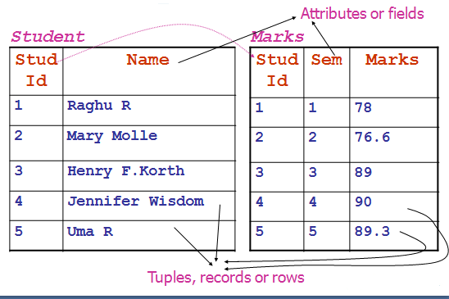

Slide 6
RDBMS Products
MS-SQL Server
Oracle
MySQL
Sybase
DB2

